Slide 1
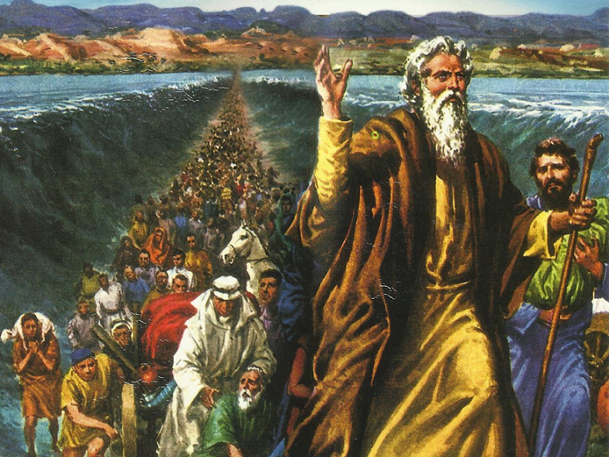
CATECHETICAL TEXTBOOK SERIES OF THE SYRO - MALABAR CHURCH
ON THE PATH OF SALVATION - 5
PEOPLE WHO AWAITED THE REDEEMER
5

Slide 2
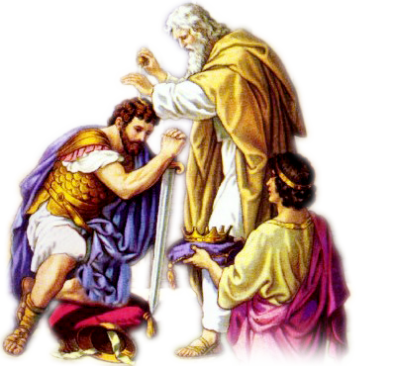
LESSON 13
THE LEADERS OF ISRAEL

Slide 3
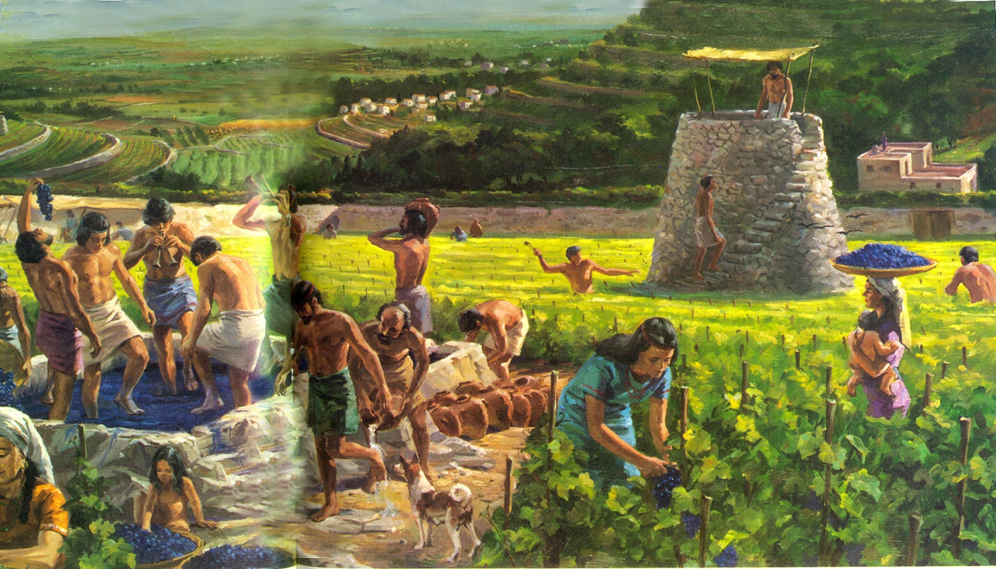
After defeating the Canaanites and occupying the Promised Land. The people of Israel settled there. Gradually they grow into a strong Nation. But Israel had to encounter a number of enemies. The peoples that were not defeated by Israel were waiting for an opportunity to attack them.

Slide 4
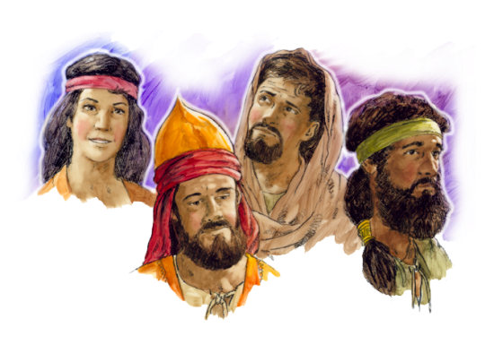
JUDGES
Leaders who had special talents and divine blessing to lead the people, were known as judges.
These leaders also acted as judges, listening to the complaints of the people, arbitrating and handling down judgments.
But the bible, presents them not as judges, but as soldiers.
Israel had been under the rule of judges for two long centuries. The book of judges in old testament describes the history of twelve. judges.
Deborah was one among them. The last of the judges was Samuel. There are two books in the old testament in his name.

Slide 5
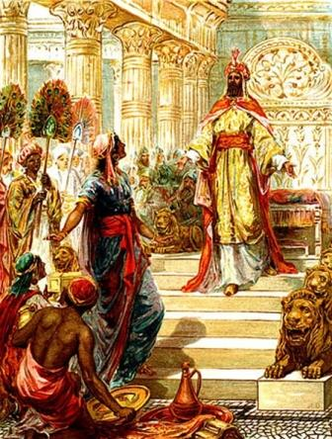
KINGS
The Israelites who had been liberated from slavery in Egypt were directly ruled and led by God. God was their king.
But this state of affairs came to an end during the time of prophet Samuel. The people of Israel longed for a king.
Samuel prayed to know the will of God. And the Lord spoke to Samuel: ”Now therefore, listen to their voice. However you shall solemnly warn them, and show them the ways of the king who shall
Reign over them”. (1 Sam.8:9)

Slide 6
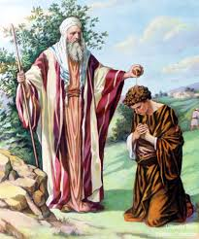
SAUL : THE FIRST KING
A young man by the name ‘Saul’ came to Samuel. He was going around in search of his father’s missing donkey. God had informed Samuel about Saul’s arrival much in advance.
Samuel anointed Saul. Samuel took a vial of olive oil and poured it on Saul’s head. Kissing him Samuel said: ”The Lord has anointed you to rule over his people of Israel. You shall reign over them and you will save them from the hand of their enemies all round.” (1 Sam.10:1)
Anoint means “to offer in the service of God”.
The kingship of Saul was for the purpose of serving God.
Saul was a brave ruler. But after sometime he lost favor with God because he was selfish and autocratic in his rule.

Slide 7
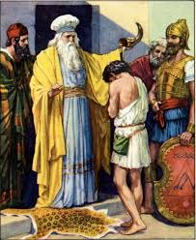
DAVID: THE POWERFUL RULER
According to the Lord’s command Samuel anointed David with oil and since that day the spirit of the Lord dwelt upon David.
David was brave, wise and handsome and Saul liked him very much. Mean time Goliath a Champion from army of Philistines challenged the Israelites. David defeated Goliath by hitting him with a stone from his sling. When the champion fell David took Goliath’s own sword and beheaded him.
After this Saul appointed David as the general of his army. Soon after David was popular among people and Saul couldn’t bare this fact he became jealous and made attempts to have him killed. But David didn’t show any grudge against Saul.
Saul and his sons were killed in a battle and David became the king of Israel.

Slide 8
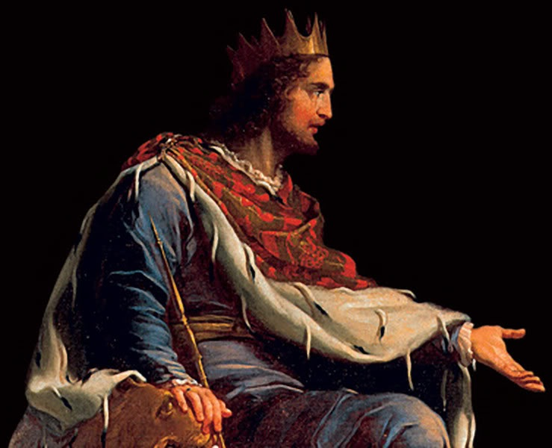
SOLOMON : THE WISE KING
Before David died he anointed his son Solomon as king. Solomon is known as the wise king in the Israel’s history.
King Solomon built a beautiful temple for the lord in Jerusalem. In wealth and wisdom he was above all kings on earth.
Like David even Solomon sinned against God. His offence was idolatry. God became angry with Solomon and said his kingdom would be divided.
And accordingly after Solomon’s time two kingdom Judah and Israel came into being.
THE KINGS OF ISRAEL WERE ORDAINED NOT TO ENACT NEW LAWS BUT TO ADMINISTER THE LAW GIVEN BY GOD.

Slide 9
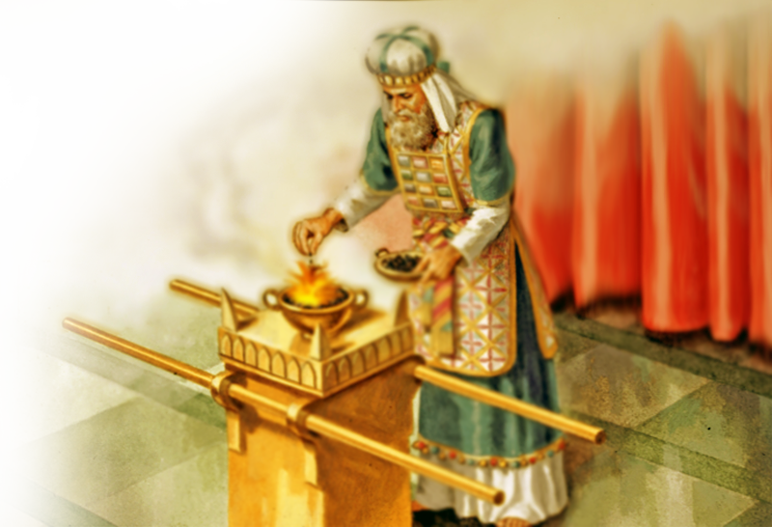
PRIEST
Earlier Israel had no priest but when the ark and the tabernacle were made those who were appointed to serve and protect were called priest.
This duty was entrusted to Aaron and his children.
Priest were appointed to offer sacrifices to the Lord on behave of the people and to bless the people in the name of the lord.
In the mean time priesthood went to the tribe of Levi. Levi was one of the twelve sons of Jacob.
The three responsibility of priests were
- Serving at the alter.
- Offer sacrifices to the Lord
- Teaching the laws
Priesthood is the symbol of relationship between the people of Israel and God.

Slide 10
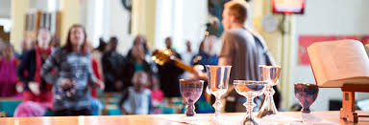
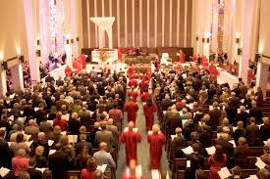
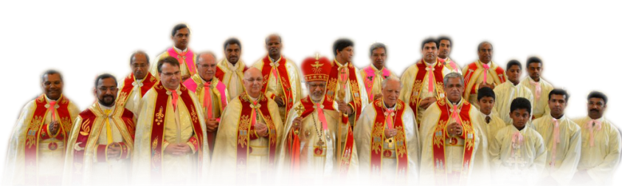
SERVICES OF THE CHURCH
Church also has leadership functions comprising prophetic, kingly and priestly duties. This service of Jesus today continues through Bishops, Priests and deacons.
In the universal catholic church the leadership role is vested in the pope. Those involved in the church services promote the growth of church. Let us grow by recognizing the church leadership

Slide 11
Let us pray
O God, who called us to grow in holiness, help us lead a life fulfilling our duties.

Slide 12
READ AND RECOUNT
Narrate the event related with the election of Samuel [1Samuel.3.1-12].

Slide 13

WORD OF GOD FOR GUIDANCE
Serve your Lord faithfully with all
your heart [1Samuel.12:24].

Slide 14
MY DECISION
I will lead pleasing to Jesus by doing my duties faithfully.

Slide 15
LET US DO
Pair the following
David
First King
Solomaon
Last Judge
Saul
Priest
Samuel
Wise King
Aaron
Powerful King

Slide 16
LET US FIND OUT THE ANSWER
1. Who were known as the judges in Israel?
2. What do you mean by anointing?
3. What were the responsibilities of the priests in Israel?
4. Who is known as the successor of Peter?
5. What for were the kings of Israel appointed?

Slide 17
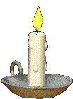


Thank you

